Slide 1
Grouping objects
Introduction to collections
5.0

Slide 2
Main concepts to be covered
Collections (especially ArrayList)
Builds on the abstraction theme from the last chapter.

Slide 3
The requirement to group objects
Many applications involve collections of objects:
Personal organizers.
Library catalogs.
Student-record system.
The number of items to be stored varies.
Items added.
Items deleted.

Slide 4
An organizer for music files
Track files may be added.
There is no pre-defined limit to the number of files.
It will tell how many file names are stored in the collection.
It will list individual file names.
Explore the music-organizer-v1 project.

Slide 5
Class libraries
Collections of useful classes.
We don’t have to write everything from scratch.
Java calls its libraries, packages.
Grouping objects is a recurring requirement.
The java.util package contains classes for doing this.

Slide 6
import java.util.ArrayList;
/**
* ...
*/
public class MusicOrganizer
{
// Storage for an arbitrary number of file names.
private ArrayList<String> files;
/**
* Perform any initialization required for the
* organizer.
*/
public MusicOrganizer()
{
files = new ArrayList<String>();
}
...
}

Slide 7
Collections
We specify:
the type of collection: ArrayList
the type of objects it will contain: <String>
private ArrayList<String> files;
We say, “ArrayList of String”.

Slide 8
Generic classes
Collections are known as parameterized or generic types.
ArrayList implements list functionality:
add, get, size, etc.
The type parameter says what we want a list of:
ArrayList<Person>
ArrayList<TicketMachine>
etc.

Slide 9
Creating an ArrayList object
In versions of Java prior to version 7:
files = new ArrayList<String>();
Java 7 introduced ‘diamond notation’
files = new ArrayList<>();
The type parameter can be inferred from the variable being assigned to.
A convenience.

Slide 10
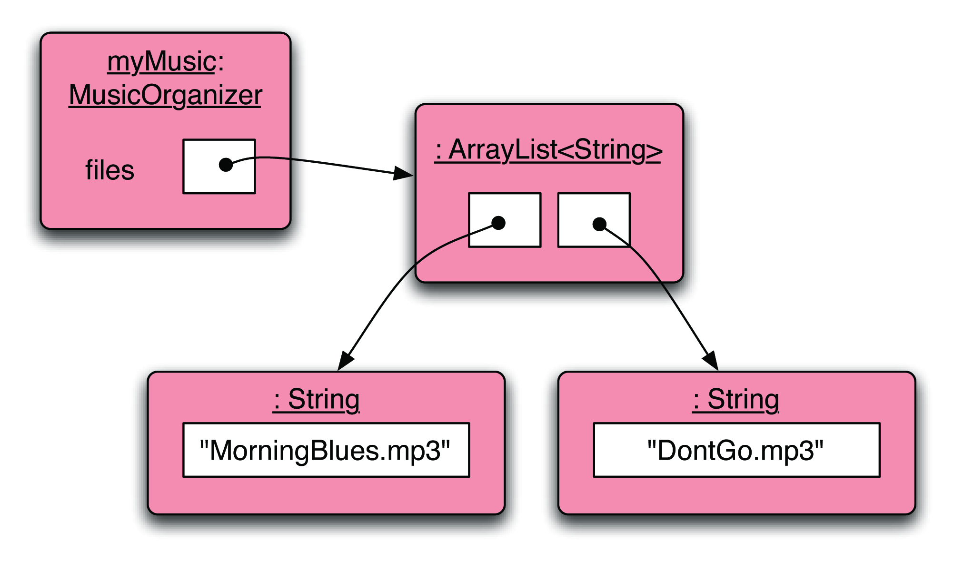
Object structures with collections

Slide 11
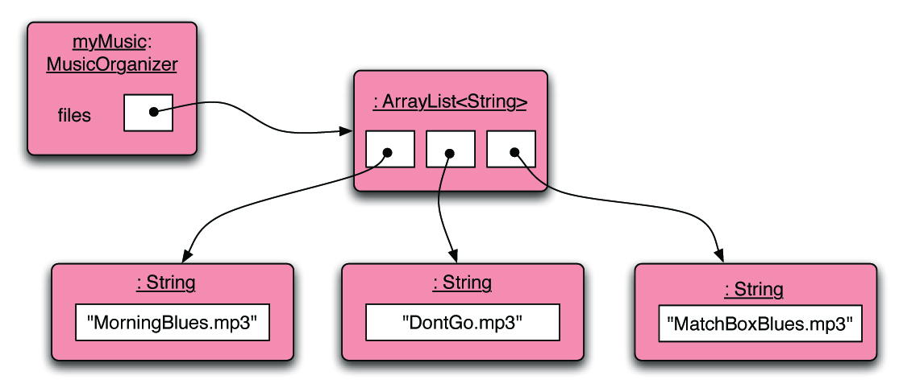
Adding a third file

Slide 12
Features of the collection
It increases its capacity as necessary.
It keeps a private count:
size() accessor.
It keeps the objects in order.
Details of how all this is done are hidden.
Does that matter? Does not knowing how prevent us from using it?

Slide 13
Using the collection
public class MusicOrganizer
{
private ArrayList<String> files;
...
public void addFile(String filename)
{
files.add(filename);
}
public int getNumberOfFiles()
{
return files.size();
}
...
}
Adding a new file
Returning the number of files
(delegation)

Slide 14
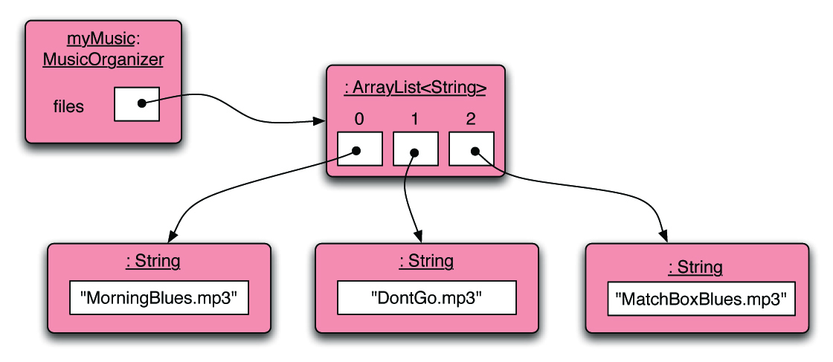
Index numbering

Slide 15
Retrieving an object
public void listFile(int index)
{
if(index >= 0 &&
index < files.size()) { String filename = files.get(index);
System.out.println(filename);
}
else {
// This is not a valid index.
}
}
Index validity checks
Retrieve and print the file name
Needed? (Error message?)

Slide 16
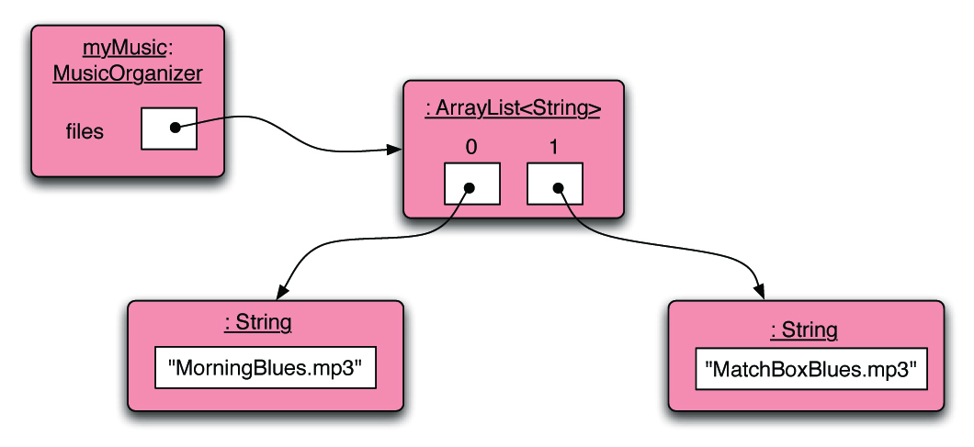
Removal may affect numbering

Slide 17
The general utility of indices
Using integers to index collections has a general utility:
‘next’ is: index + 1
‘previous’ is: index – 1
‘last’ is: list.size() – 1
‘the first three’ is: the items at indices 0, 1, 2
We could also think about accessing items in sequence: 0, 1, 2, …

Slide 18
Review
Collections allow an arbitrary number of objects to be stored.
Class libraries usually contain tried-and-tested collection classes.
Java’s class libraries are called packages.
We have used the ArrayList class from the java.util package.

Slide 19
Review
Items may be added and removed.
Each item has an index.
Index values may change if items are removed (or further items added).
The main ArrayList methods are add, get, remove and size.
ArrayList is a parameterized or generic type.

Slide 20
Interlude: Some popular errors...

Slide 21
/** * Print out info (number of entries). */ public void showStatus() { if(files.size() == 0); { System.out.println("Organizer is empty"); } else { System.out.print("Organizer holds "); System.out.println(files.size() + " files"); } }
What’s wrong here?

Slide 22
/** * Print out info (number of entries). */ public void showStatus() { if(files.size() == 0); { System.out.println("Organizer is empty"); } else { System.out.print("Organizer holds "); System.out.println(files.size() + "files"); } }
This is the same as before!

Slide 23
/** * Print out info (number of entries). */ public void showStatus() { if(files.size() == 0) ; { System.out.println("Organizer is empty"); } else { System.out.print("Organizer holds "); System.out.println(files.size() + "files"); } }
This is the same again

Slide 24
/** * Print out info (number of entries). */ public void showStatus() { if(files.size() == 0) { ; } { System.out.println("Organizer is empty"); } else { System.out.print("Organizer holds "); System.out.println(files.size() + "files"); } }
and the same again…

Slide 25
/** * Print out info (number of entries). */ public void showStatus() { if(isEmpty = true) { System.out.println("Organizer is empty"); } else { System.out.print("Organizer holds "); System.out.println(files.size() + "files"); } }
This time I have a boolean field called ‘isEmpty’...
What’s wrong here?

Slide 26
/** * Print out info (number of entries). */ public void showStatus() { if(isEmpty == true) { System.out.println("Organizer is empty"); } else { System.out.print("Organizer holds "); System.out.println(files.size() + "files"); } }
This time I have a boolean field called ‘isEmpty’...
The correct version

Slide 27
/** * Store a new file in the organizer. If the * organizer is full, save it and start a new one. */ public void addFile(String filename) { if(files.size() == 100) files.save(); // starting new list files = new ArrayList<String>(); files.add(filename); }
What’s wrong here?

Slide 28
/** * Store a new file in the organizer. If the * organizer is full, save it and start a new one. */ public void addFile(String filename) { if(files.size == 100) files.save(); // starting new list files = new ArrayList<String>(); files.add(filename); }
This is the same.

Slide 29
/** * Store a new file in the organizer. If the * organizer is full, save it and start a new one. */ public void addFile(String filename) { if(files.size == 100) { files.save(); // starting new list files = new ArrayList<String>(); } files.add(filename); }
The correct version

Slide 30
Grouping objects
Collections and the for-each loop

Slide 31
Main concepts to be covered
Collections
Loops: the for-each loop

Slide 32
Iteration
We often want to perform some actions an arbitrary number of times.
E.g., print all the file names in the organizer. How many are there?
Most programming languages include loop statements to make this possible.
Java has several sorts of loop statement.
We will start with its for-each loop.

Slide 33
Iteration fundamentals
We often want to repeat some actions over and over.
Loops provide us with a way to control how many times we repeat those actions.
With collections, we often want to repeat things once for every object in a particular collection.

Slide 34
For-each loop pseudo code
General form of the for-each loop
for keyword
loop header
for(ElementType element : collection) {
loop body
}
Statement(s) to be repeated
Pseudo-code expression of the actions of a for-each loop
For each element in collection, do the things in the loop body.

Slide 35
A Java example
/**
* List all file names in the organizer.
*/
public void listAllFiles()
{
for(String filename : files) {
System.out.println(filename);
}
}
for each filename in files, print out filename

Slide 36
Review
Loop statements allow a block of statements to be repeated.
The for-each loop allows iteration over a whole collection.

Slide 37
Selective processing
Statements can be nested, giving greater selectivity:
public void findFiles(String searchString)
{
for(String filename : files) {
if(filename.contains(searchString)) { System.out.println(filename); }
}
}

Slide 38
Critique of for-each
Easy to write.
Termination happens naturally.
The collection cannot be changed.
There is no index provided.
Not all collections are index-based.
We can’t stop part way through;
e.g. find-the-first-that-matches.
It provides ‘definite iteration’ – aka ‘bounded iteration’.

Slide 39
Grouping objects
Indefinite iteration - the while loop

Slide 40
Main concepts to be covered
The difference between definite and indefinite (unbounded) iteration.
The while loop

Slide 41
Search tasks are indefinite
We cannot predict, in advance, how many places we will have to look.
Although, there may well be an absolute limit – i.e., checking every possible location.
‘Infinite loops’ are also possible.
Through error or the nature of the task.

Slide 42
The while loop
A for-each loop repeats the loop body for each object in a collection.
Sometimes we require more variation than this.
We use a boolean condition to decide whether or not to keep going.
A while loop provides this control.

Slide 43
While loop pseudo code
General form of a while loop
while keyword
boolean test
while(loop condition) {
loop body
}
Statements to be repeated
Pseudo-code expression of the actions of a while loop
while we wish to continue, do the things in the loop body

Slide 44
Looking for your keys
while(the keys are missing) {
look in the next place;
}
Or:
while(not (the keys have been found)) {
look in the next place;
}

Slide 45
Looking for your keys
boolean searching = true;
while(searching) {
if(they are in the next place) {
searching = false;
}
}
Suppose we don’t find them?

Slide 46
A Java example
/**
* List all file names in the organizer.
*/
public void listAllFiles()
{
int index = 0;
while(index < files.size()) { String filename = files.get(index);
System.out.println(filename);
index++;
}
}
Increment index by 1
while the value of index is less than the size of the collection, get and print the next file name, and then increment index

Slide 47
Elements of the loop
We have declared an index variable.
The condition must be expressed correctly.
We have to fetch each element.
The index variable must be incremented explicitly.

Slide 48
for-each versus while
for-each:
easier to write.
safer: it is guaranteed to stop.
while:
we don’t have to process the whole collection.
doesn’t even have to be used with a collection.
take care: could be an infinite loop.

Slide 49
Searching a collection
A fundamental activity.
Applicable beyond collections.
Necessarily indefinite.
We must code for both success and failure – exhausted search.
Both must make the loop’s condition false.
The collection might be empty.

Slide 50
Finishing a search
How do we finish a search?
Either there are no more items to check: index >= files.size()
Or the item has been found: found == true found ! searching

Slide 51
Continuing a search
With a while loop we need to state the condition for continuing:
So the loop’s condition will be the opposite of that for finishing: index < files.size() && ! found index < files.size() && searching
NB: ‘or’ becomes ‘and’ when inverting everything.

Slide 52
Searching a collection
int index = 0;
boolean found = false;
while(index < files.size() && !found) {
String file = files.get(index);
if(file.contains(searchString)) {
// We don't need to keep looking.
found = true;
}
else {
index++;
}
}
// Either we found it at index,
// or we searched the whole collection.

Slide 53
Indefinite iteration
Does the search still work if the collection is empty?
Yes! The loop’s body won’t be entered in that case.
Important feature of while:
The body will be executed zero or more times.

Slide 54
While without a collection
// Print all even numbers from 2 to 30.
int index = 2;
while(index <= 30) {
System.out.println(index);
index = index + 2;
}

